Slide 1
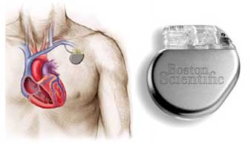
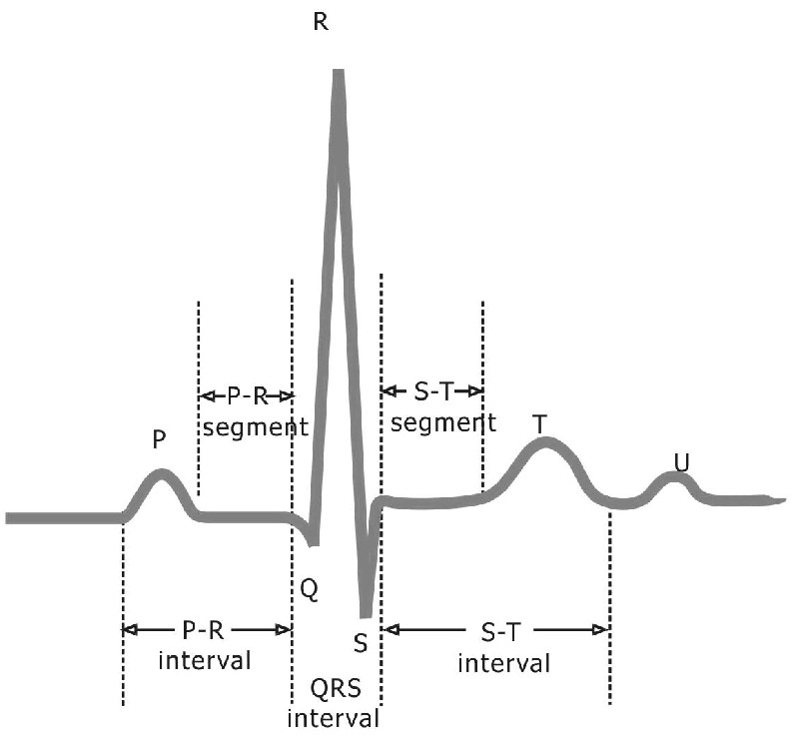
Modelling Cardiac Pacemaker Software: Towards Methodology for Complex Critical Systems
Mike Poppleton
Abdolbaghi Rezazadeh
Colin Snook

Slide 2
Roadmap
Background & motivation
Requirements ?
Electrocardiology basics
Requirements domain modelling – state diagrams
Solution domain modelling – different state diagrams
Event-B brief recap
Modelling & refinement … towards method
Further work

Slide 3
Cardiac pacemaker: a definition
The device monitors and regulates a patient’s heart rate.
The device detects and provides therapy for bradycardia conditions.
The device provides programmable, single- and dual-chamber, rate-adaptive pacing, both permanent and temporary.
In adaptive rate modes, an accelerometer is used to measure physical activity, resulting in a sensor indicated rate for pacing the heart.

Slide 4
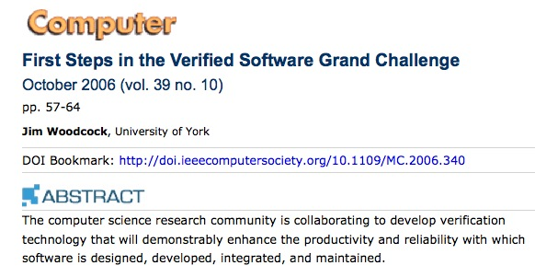
Background & motivation
One of the Grand Challenge case studies

Slide 5
Motivation
“In 1996 (in the USA), 10% of all medical device recalls were caused by software-related issues. In June of 2006, software errors in medical devices made up 21% of recalls.”
Jiang et al
In one study, 40% of cardiac complications in pacemaker-fitted patients were caused by the device

Slide 6
The specification (Boston Scientific): lots of
this (definitions):

Slide 7
The specification: and lots of
this (configuration data):
… ie very low-level, and little
behaviour is specified!

Slide 8
[Cardiac Pacing and ICDs, Kenneth A Ellenbogen and Mark A Wood]

Slide 9
[Cardiac Pacing and ICDs, Kenneth A Ellenbogen and Mark A Wood]

Slide 10
Related work etc

Slide 11
Motivation: related work
A number of teams have modelled the pacemaker, some down to code/ install on test devices
Not much evidence of refinement
Not much evidence of abstraction; cue taken from concrete style of requirement doc ?
No evidence of systematic reuse
At least 2 teams(Méry/Singh, Jiang et al) have modelled the heart (SUC) in conjunction with the pacemaker (CTL)
Méry/Singh have used Event-B, refinement and proof (but in a concrete style)
Jiang et al have used hybrid models and simulation

Slide 12
Motivation: ours
Opportunities for systematic reuse (23 operational modes with common behaviours)
In search of more explicit repeatable modelling methodology
State diagram modelling
gives elegant process models of requirements
which map simply to guide modelling and refinement in Event-B
gives a syntactic vehicle for structured reuse
Exploration of synchronisation modelling
Investigation of modelling styles for time – starting with Cansell/Mery

Slide 13
To date we have:
Modelled 5 modes
initially in CSP, then in a requirements-domain state diagram notation
interpreted these in the solution domain of Event-B
then refined down to introduction of explicit time intervals
Model/verify(proof, model-check)/remodel cycle
Concerns:
no (more) requirements analysis (than anyone else)

Slide 16
<- Also known as AEI

Slide 18
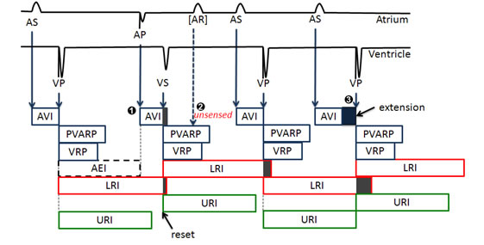
Behaviour: timing-driven sensing and pacing(DDD)

Slide 19
SenseA
PaceA
SenseA
SenseA
RefA
MonA
RefA
MonA
RefA
MonA
RefA
PaceV
SenseV
PaceV
PaceV
MonV
RefV
MonV
RefV
MonV
RefV
MonV
RefV

Slide 20
Requirements domain model – AAI

Slide 21
Requirements domain models – AAI, VVI
AAI
VVI
NB - reuse: AAI -> VVI is simple refactoring by renaming

Slide 22
Requirements domain model - VDD
NB: Synchronisation scheme between channels
NB – reuse: Each channel is an extended subgraph of AAI modulo renaming

Slide 23
Event-B Overview
Two main elements: Contexts & Machines
Context: static model data and its logical properties
Machine: dynamic model variables (state), invariants on variables, state-updating events (behaviour)
Refinement: formal design transformation – layer in requirements, add architectural/implementation structure, (algorithmic) behaviour

Slide 24
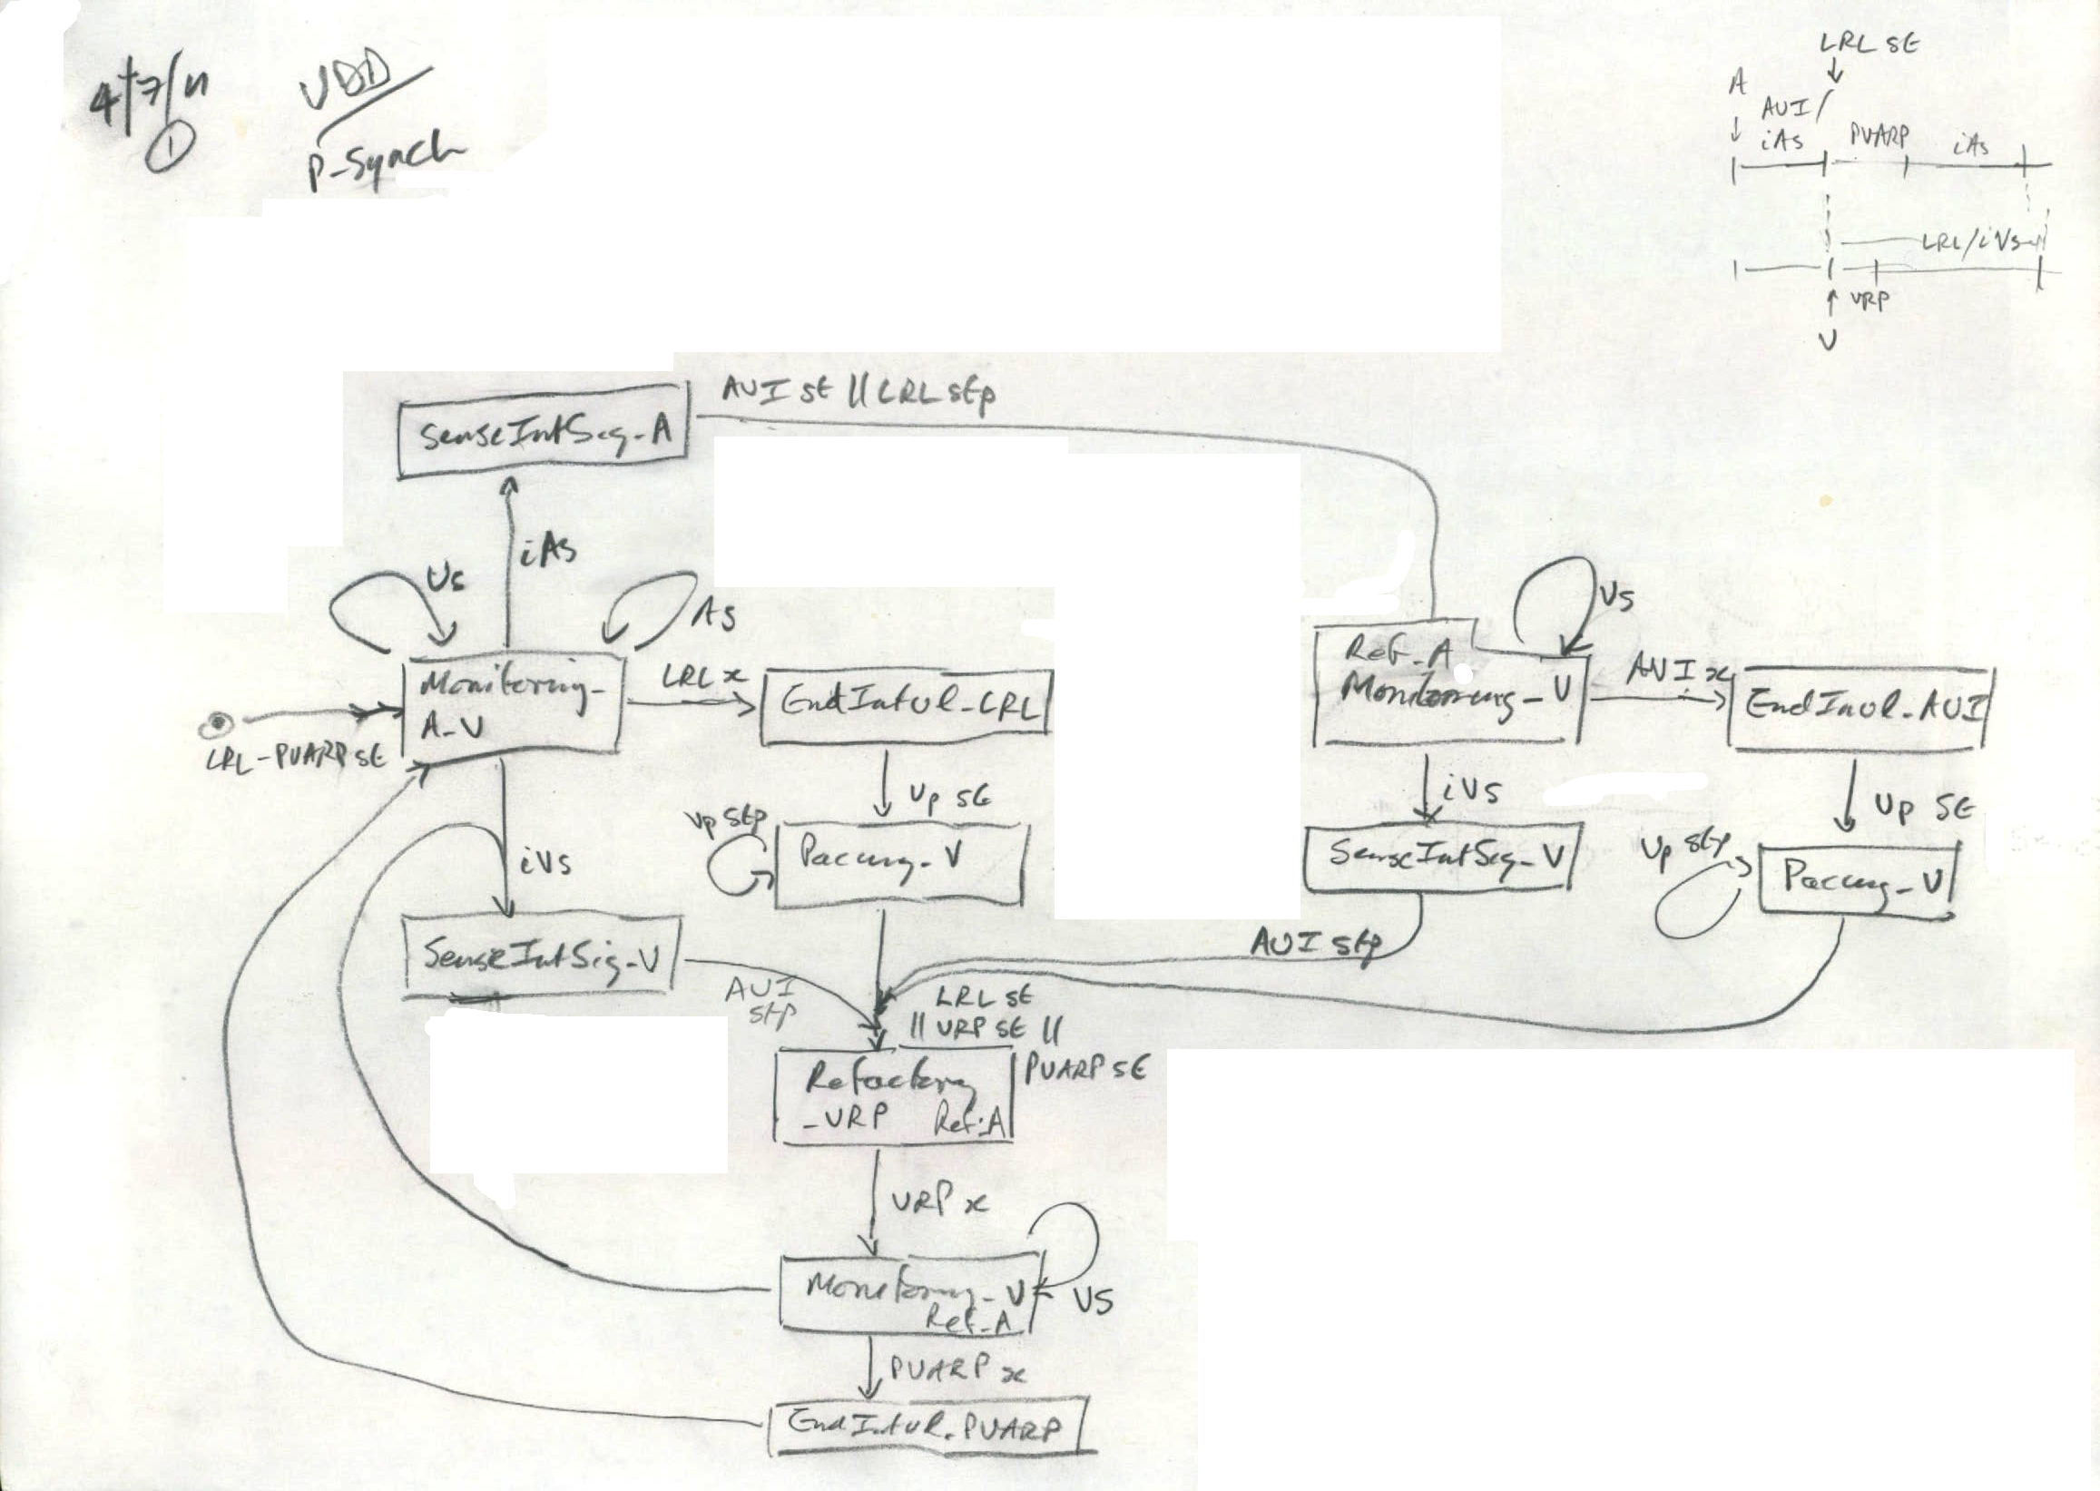
Handling Complexity

Slide 25
Solution domain AAI : Abstract state machine

Slide 26
Requirements to solution domain AAI : Abstract state machine

Slide 27
AAI: Event-B Abstract Spec.

Slide 28
AAI – State machine rep. of the first refinement

Slide 29
AAI - First refinement

Slide 30
AAI - First refinement(cont.)

Slide 31
AAI – State machine rep. of the timing refinement

Slide 32
Requirements -> solution domain mapping

Slide 33
Abstract
Refined

Slide 34
AAI: Second refinement – Introducing Timing properties

Slide 35
VDD Mode - Reuse
Generic Models
A Channel
V Channel

Slide 36
VDD Mode – synchronisation – refinement 1
A Channel
V Channel

Slide 37
VDD Mode – synchronisation – refinement 1
Requirements elicitation: ProB animation and model-checking of first refinement showed excessive event enablement, i.e. :
While A int-signal being processed, V pacing and int-signal processing is suspended
A sensed A int-signal must be (i) reported to V channel for synchronisation/suspension, and (ii) processed in a timely manner. (iii) Completion of processing must be reported to V channel for synchronisation/resumption
And vice-versa for V int-signal or pace
These are requirements on
signal flags pace_signal, intrinsic_signal_A, intrinsic_signal_V
synch flags a2vSignal, v2a_signal

Slide 38
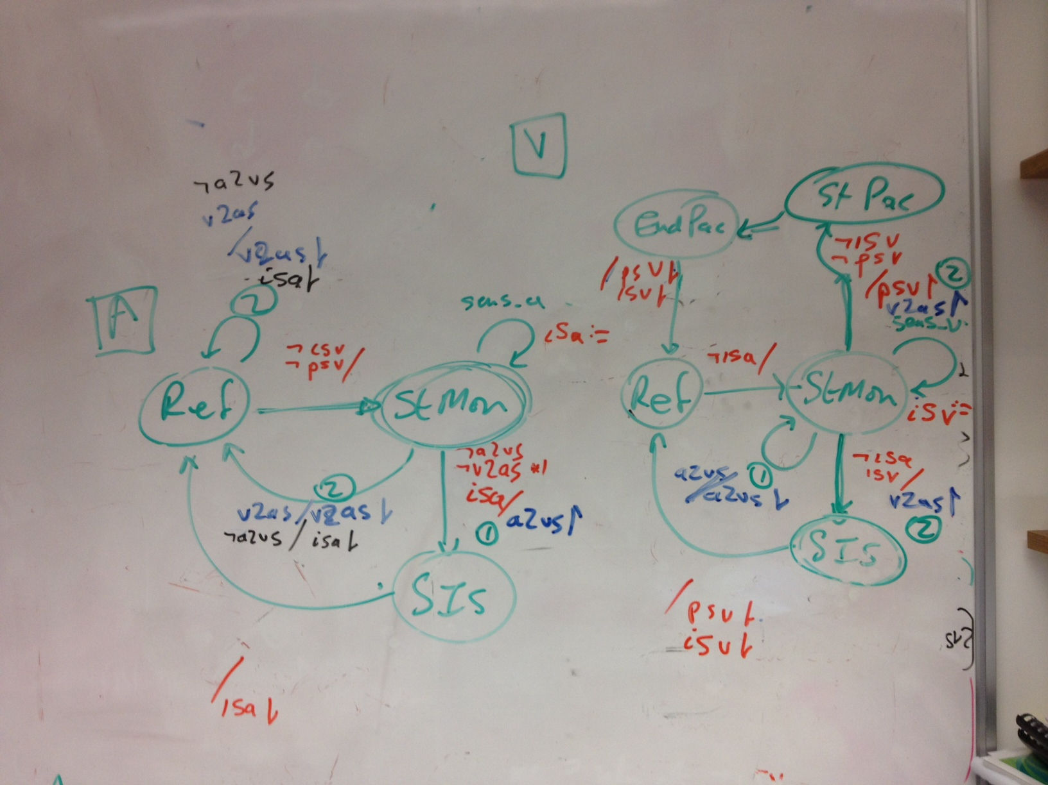

Slide 39
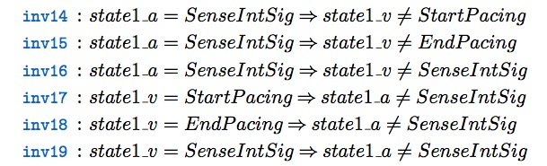
VDD Mode – synchronisation – refinement 1a
A Channel
V Channel
Statically encode these requirements as safety invariants in 2 refinement steps
Strip out signals
Stop channels from being simultaneously active:

Slide 40
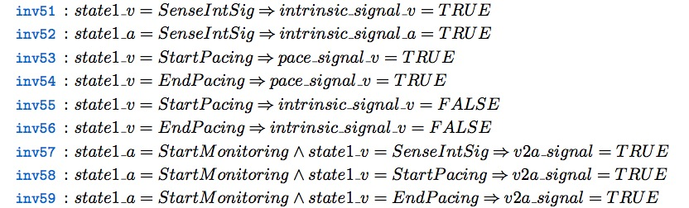
VDD Mode – synchronisation – refinement 1b
A Channel
V Channel
Replace signals
Replace direct cross-chamber references with signal properties of each state :

Slide 41
VDD Mode – Event-B Rep.

Slide 42
VDD Mode – Event-B Rep.

Slide 43
Conclusion
We have:
modelled AAI, VVI, DVI, VDD, DDD modes
in a flat requirements-domain state diagram notation
mapped this to a refinement chain of state machines in the solution domain (of Event-B)
explored loose synchronisation modelling (for concurrent code)
sketched a method pattern of dynamic -> static verification loop
identified statemachine-based reuse patterns
progressed statemachine design & animation tool support for Event-B
started investigation of adapted (from Cansell/Mery) modelling style for time

Slide 44
Further work
Continue:
Synchronisation/ implementation design
Timing elaboration
State machine plugin & animation development
Functional development: hysteresis, rate modulation
Systematize statemachine-based reuse, develop tool support (building on the feature composition plugin)
Heart modelling for simulation-based testing of pacemaker
Utility of process (eg CSP) modelling ?
Continuous modelling of sensing / pacing mechanics ?

Slide 45
That’s it folks.

